Slide 1
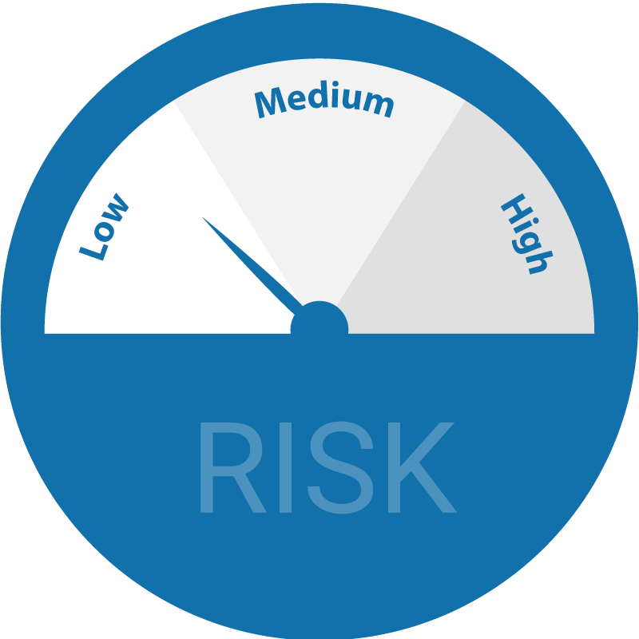




CREDIT SPREADS IN THE NBFC SECTOR OF INDIA
By
Aanchal Dusija A009
Rhea Mirchandani A018
Shiven Khosla A035

Slide 2

DEBT MARKET
The Indian debt market is a market meant for trading fixed income instruments.
A bond/debt can be defined as a loan in which an investor is the lender.
The Indian debt market offers a variety of debt instruments, offered by the Government and non-Government entities.
DEBT MARKET
GOVERNMENT SECURITES MARKET
CORPORATE DEBT MARKET

Slide 3

RISKS IN THE DEBT MARKET
CREDIT RISK
The risk that the issuer will not pay the coupon income and/ or the maturity amount on the specified dates.
INTEREST RATE RISK
The risk that interest rates may rise, causing a fall in value of traded debt instruments.
SETTLEMENT RISK
The risk that one party will fail to deliver the terms of a contract with another party at the time of settlement is called settlement risk.
LIQUIDITY RISK
The risk arising from the lack of possibility to either buy or sell a security quickly as per one’s requirement is called liquidity risk.

Slide 4


CREDIT RISK
Credit risk is the risk that a person or organisation will fail to make a payment they have promised.
A credit event is an event that will trigger the default of a bond and the borrower’s ability to pay comes into question.
The fraction of the defaulted amount that can be recovered through bankruptcy proceedings or some other form of settlement is known as the recovery rate.

Slide 5
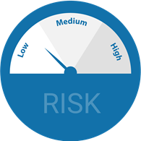
MODELING CREDIT RISK
STRUCTURAL MODELS
REDUCED-FORM MODELS
INTENSITY-BASED MODELS
Notes:
Speaking this, not writing

Slide 6

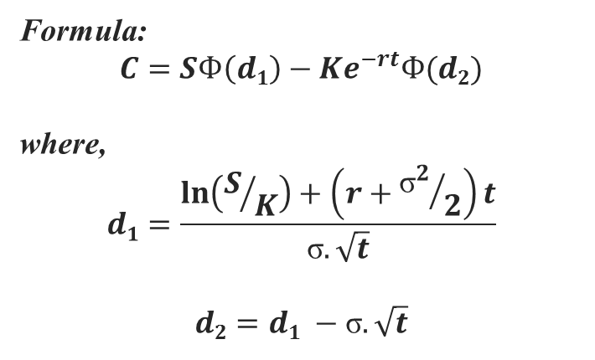

THE BLACK-SCHOLES MODEL
The Black-Scholes Model is a mathematical model of financial derivative markets which is used for pricing European call options.s
It is used to calculate the theoretical value of European-style options by taking the following variables into consideration: current stock prices(S), the option's strike price(K), time to expiration(t), implied volatility(σ), risk-free interest rates(r).
Formula:
$$C=SФ\left(d1\right)−Ke^{−rt}Ф(d2)$$
where,
$$d1=\frac{\ln\left(S/K\right)+\left(r+{{\text{σ}}^{2}}/2\right)t}{\text{σ}.\sqrt{t}}$$
$$d2=d1 −\text{σ}.\sqrt{t}$$
C = Call Premium
S = Current Stock Price
t = Time to Maturity
K = Strike Price
r = Risk-free Rate
$Ф$ = Cumulative Standard Normal Distribution
σ = Standard Deviation

Slide 7
ASSUMPTIONS OF BLACK SCHOLES MODEL
The price of the underlying share follows a Geometric Brownian Motion.
There are no risk-free arbitrage opportunities.
The risk-free rate of interest and volatility of the underlying are known and constant.
Unlimited short selling (i.e. negative holdings) is allowed.
There are no taxes or transaction costs.
The underlying asset can be traded continuously and in infinitesimally small numbers of units.

Slide 8



THE MERTON MODEL
The Merton model is an structural model used to calculate the company’s equity.
Investors and analysts use this model to understand if the companies can meet their financial obligations and not run into a credit default.
Formula:
$E=F\left(t\right)Ф\left(d1\right)−Le^{−r(t)}Ф$(d₂)
where,
$$d1=\frac{\ln\left(F/L\right)+\left(r+{{\text{σ}}^{2}}/2\right)t}{\text{σ}.\sqrt{t}}$$
$$d2=d1 −\text{σ}.\sqrt{t}$$
E = Theoretical value of a company's equity
F(t) = Value of company's assets in period t
L = Value of company's debt
t = Time to maturity
r = Risk free interest rate
$\text{ϕ}$ = Cumulative standard normal distribution
σ = Standard deviation of stock returns.

Slide 9
ASSUMPTIONS of the merton model
All options are European and are exercised only at the time of expiration.
No dividends are paid out.
Market movements are unpredictable (efficient markets).
No commissions are included.
Underlying stocks' volatility and risk-free rates are constant.
Returns on underlying stocks are regularly distributed.

Slide 10

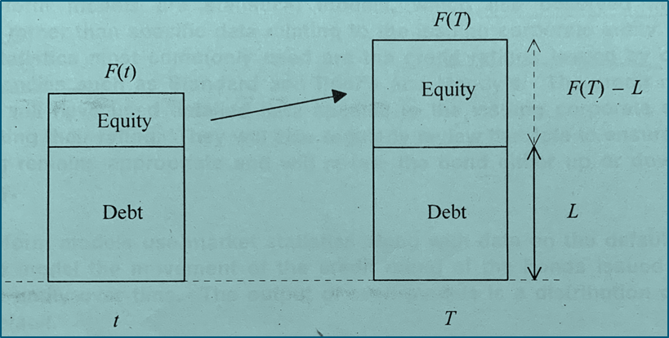
The black-Scholes-Merton model
Total value at time t : F(t)
Debt with a promised future repayment amount : L
Future time: T

Slide 11
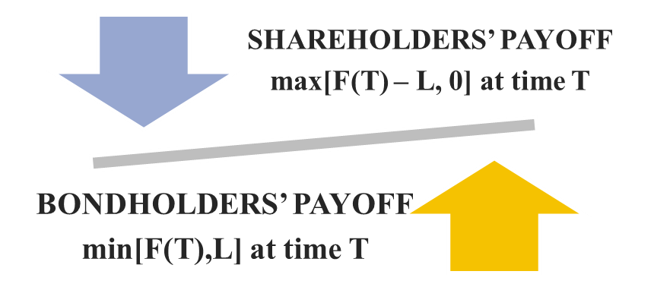

THE BLACK-SCHOLES-MERTON MODEL
If company has sufficient funds : F(T) > L
Corporate entity will default if : F(T) < L
Option will be exercised → Debt repaid
Option not be exercised → Debt not repaid

Slide 12

CREDIT SPREADs
A credit spread is the difference in yield between a Government Treasury bond and another debt security with the same maturity but of lesser quality.
It varies from one security to another based on the credit rating of the issuer of the bond.
𝐶𝑆(𝑖,𝑡) = 𝐵𝑌(𝑖,𝑡) − 𝑟𝑓(𝑡)
where
CS is the credit spread for firm, i at time t;
BY is the bond yield for firm i at time t;
rf is the risk-free interest rate at time t
Notes:
A credit spread is the difference in yield between a Government Treasury bond and another debt security with the same maturity but of lesser quality.
Credit spreads are measured in basis points, with a 1% difference in yield equal to a spread of 100 basis points.
It largely related to the expected cost of default. However, in practice it will also typically reflect other factors such as a risk premium relating to the risk of default and a liquidity premium.

Slide 13

OBJECTIVES
Calculate the value of risky corporate bonds at time t along with the credit spread for the company.
Determine the risk-neutral probability of default for three companies in the NBFC sector in India.
Compare the calculated spreads with the actual spreads for the three companies.
Explain the factors affecting credit spreads.
Comparative Analysis of Credit Spreads in India vs. Other Asian Countries.

Slide 14

DATA
The Data has been extracted from the Balance Sheets of the three companies.
The Data for FY 2017-18 has been used.
Implied volatility figures were obtained from the NSE India website.
SREI_INFRASTRUCTURE_FINANCE_LTD.xlsx
LIC_HOUSING_FINANCE_LTD.xlsx
UJJIVAN_FINANCIAL_SERVICES.xlsx

Slide 15

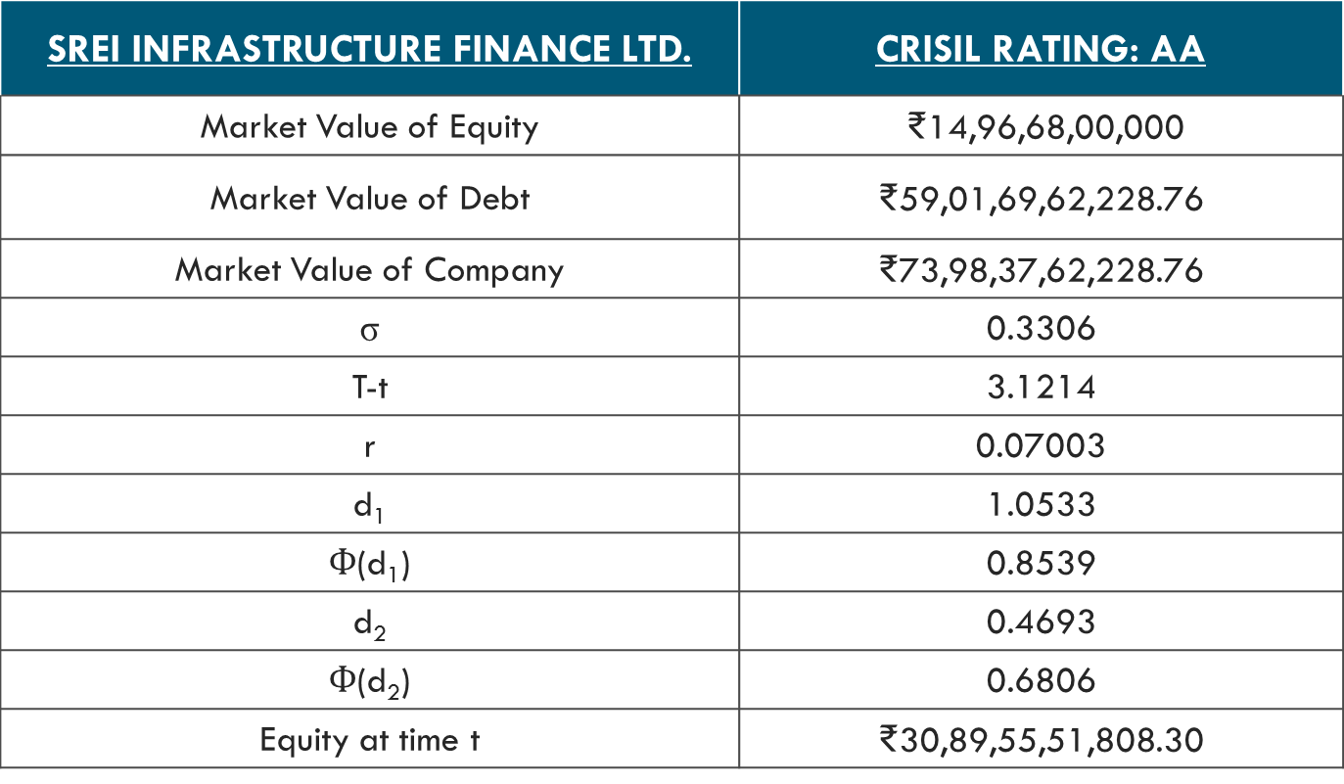
SREI INFRASTRUCTURE FINANCE LTD.
SREI INFRASTRUCTURE FINANCE LTD. | CRISIL RATING: AA
Market Value of Equity | ₹14,96,68,00,000
Market Value of Debt | ₹59,01,69,62,228.76
Market Value of Company | ₹73,98,37,62,228.76
σ | 0.3306
T-t | 3.1214
r | 0.07003
d₁ | 1.0533
$Ф$(d₁) | 0.8539
d₂ | 0.4693
$Ф$(d₂) | 0.6806
Equity at time t | ₹30,89,55,51,808.30

Slide 16
The value of the bonds could then be found by subtracting the value of equity from the current value of the company, i.e. F(t)
SREI INFRASTRUCTURE FINANCE LTD. | CRISIL RATING: AA
B(t): Current value of the Company’s risky corporate bonds | ₹43,08,82,10,420.45
Rate/ yield on bond | 10.08%
Credit Spread | 3.08%
Risk-neutral probability of default | 31.9%
Notes:
B(t) = F(t) – E(t)

Slide 17

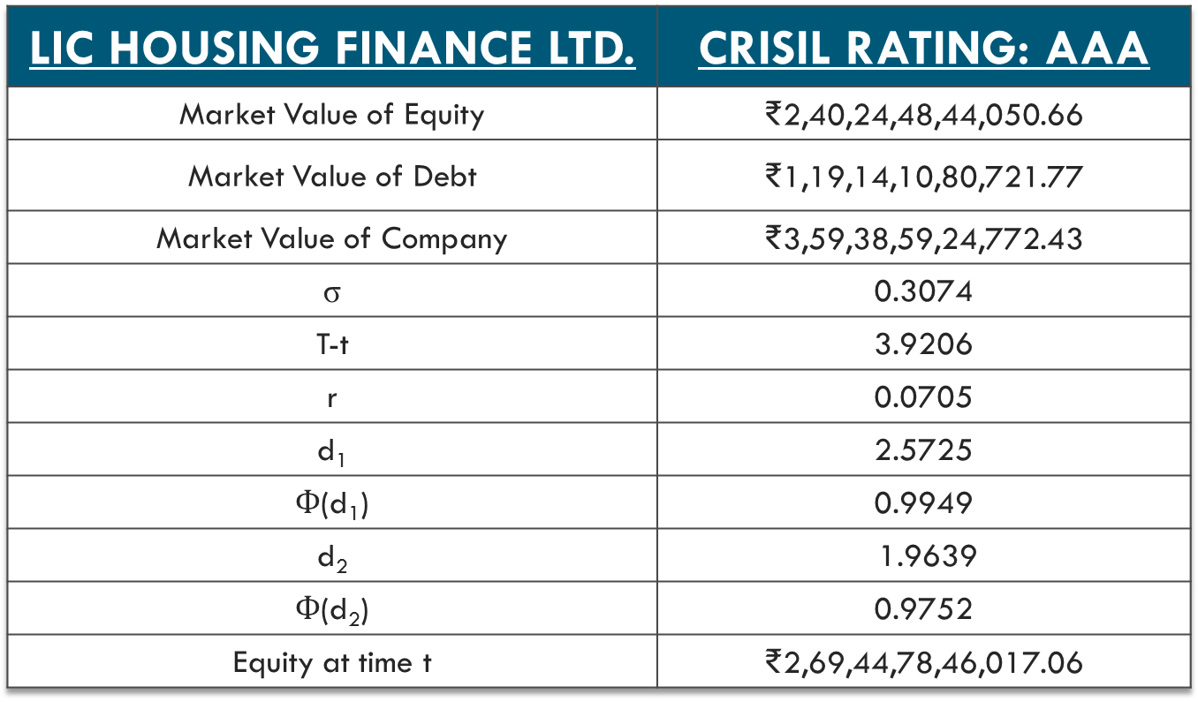
LIC HOUSING FINANCE LTD.
LIC HOUSING FINANCE LTD. | CRISIL RATING: AAA
Market Value of Equity | ₹2,40,24,48,44,050.66
Market Value of Debt | ₹1,19,14,10,80,721.77
Market Value of Company | ₹3,59,38,59,24,772.43
σ | 0.3074
T-t | 3.9206
r | 0.0705
d₁ | 2.5725
$Ф$(d₁) | 0.9949
d₂ | 1.9639
$Ф$(d₂) | 0.9752
Equity at time t | ₹2,69,44,78,46,017.06

Slide 18
LIC HOUSING FINANCE LTD. | CRISIL RATING: AAA
B(t): Current value of the Company’s risky corporate bonds | ₹89,93,80,78,755.37
Rate/ yield on bond | 7.1721%
Credit Spread | 0.12%

Slide 19
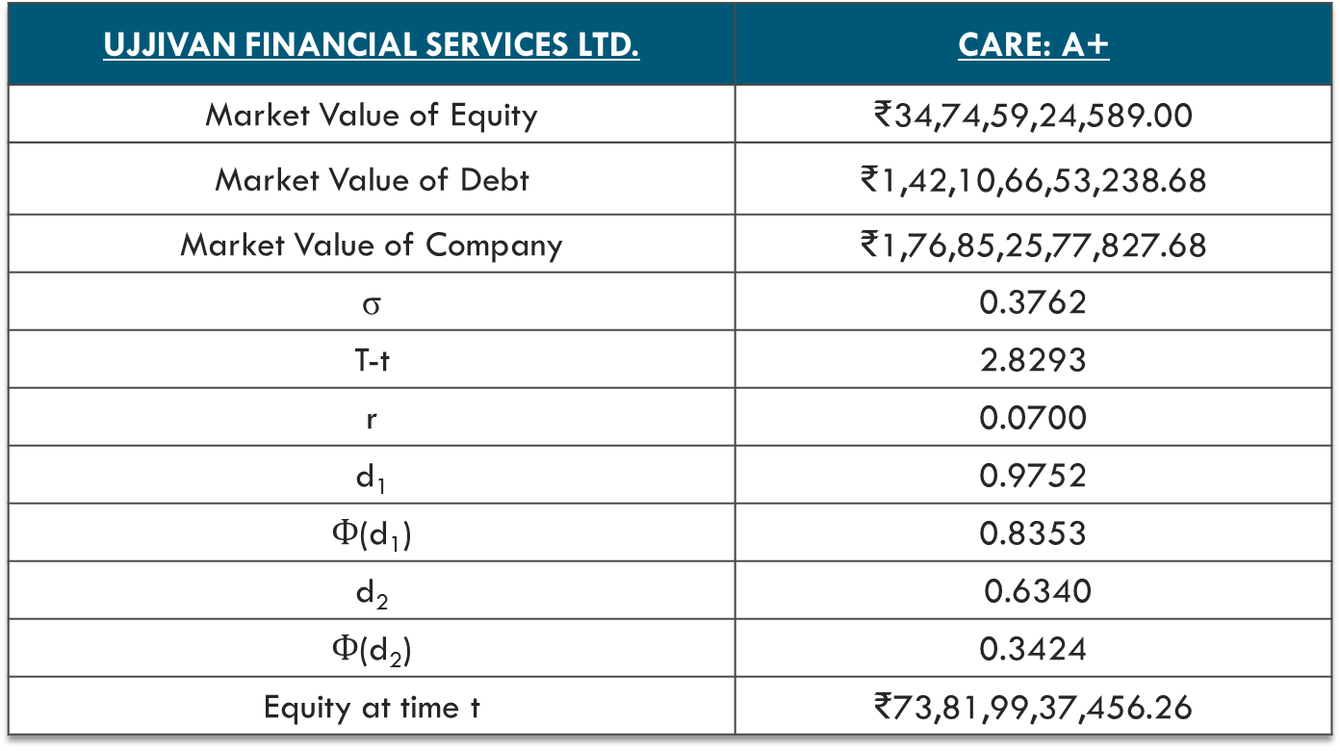
UJJIVAN FINANCIAL SERVICES LTD.
UJJIVAN FINANCIAL SERVICES LTD. | CARE: A+
Market Value of Equity | ₹34,74,59,24,589.00
Market Value of Debt | ₹1,42,10,66,53,238.68
Market Value of Company | ₹1,76,85,25,77,827.68
σ | 0.3762
T-t | 2.8293
r | 0.0700
d₁ | 0.9752
$Ф$(d₁) | 0.8353
d₂ | 0.6340
$Ф$(d₂) | 0.3424
Equity at time t | ₹73,81,99,37,456.26

Slide 20
UJJIVAN FINANCIAL SERVICES LTD. | CARE: A+
B(t): Current value of the Company’s risky corporate bonds | ₹1,03,03,26,40,371.42
Rate/ yield on bond | 11.36%
Credit Spread | 4.36%

Slide 21
RISK-NEUTRAL PROBABILITY OF DEFAULT
LIC HOUSING FINANCE: 0.025
SREI INFRASTRUCTURE FINANCE: 0.32
UJJIVAN FINANCIAL SERVICES: 0.66

Slide 22

ACTUAL VS. CALCULATED
COMPANY | ACTUAL YIELD | CALCULATED YIELD
LIC HOUSING FINANCE LTD. | 8.29% | 7.17%
SREI INFRASTRUCTURE FINANCE LTD. | 9.95% | 10.08%
UJJIVAN FINANCIAL SERVICES LTD. | 11.9% | 11.36%

Slide 23
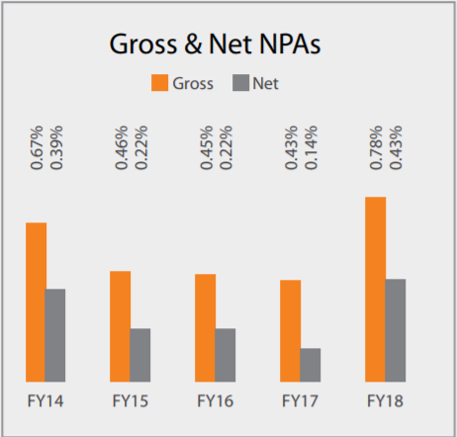
FINANCES: LIC Housing Finance
LIC Housing Finance Q4 Net Profit ₹539.33 crores
FY 2018 Loan portfolio grows 15% to ₹1,66,363 crores
Individual Loan Gross NPAs at 0.43%

Slide 24
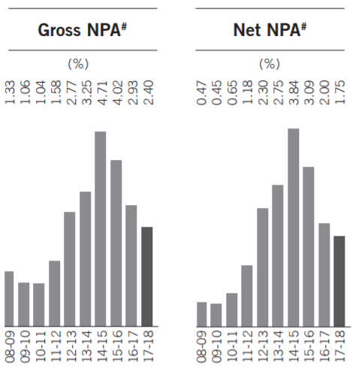
FINANCES: SREI INFRASTUCTURE FINANCE Ltd.
PAT of ₹384.55 crores in FY18
FY18 Disbursements up by 29% to ₹22,726 crores
GNPA decreased from 2.93% for FY17 to 2.40% for FY18 and NNPA decreased from 2% for FY17 to 1.75% for FY18

Slide 25
FINANCES: SREI INFRASTUCTURE FINANCE Ltd.
Other current and non-current liabilities increased by about 54% to ₹2,799 crores
Other long term and current liabilities increased by 39% to ₹1,088 crores
Trade payables increased by about 66% to ₹1,712 crores

Slide 26
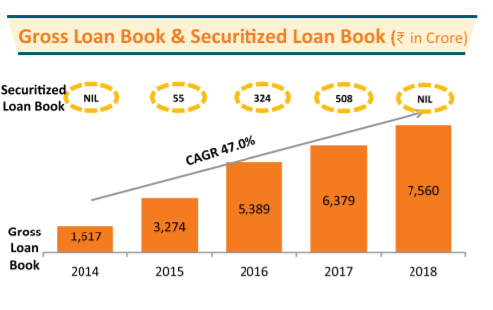
FINANCES: Ujjivan housing finance
Loan book of ₹7,560 crores marking 18.5 % growth over the previous year

Slide 27
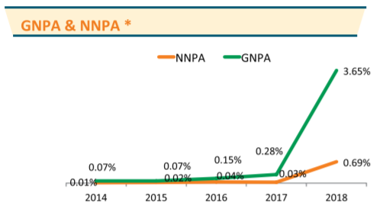
FINANCES: Ujjivan housing finance
PAT decreased to ₹7.28 crores from a previous year of ₹207.67 crores
The GNPA and NNPA rose sharply over FY17-18

Slide 28
FACTORS AFFECTING CREDIT SPREADS
Inflation
Risk-free Rate
Tax Effects
Liquidity Risk
Economy Strength
Probability of Default
Stock Market Index and Market Cap
Embedded Options

Slide 29

FACTORS AFFECTING CREDIT SPREADS
WIDENING
TIGHTENING
- Inflation
- Probability of Default
- Liquidity
- Economy Strength (GDP)
- Tax Effects
- Inflation
- Probability of Default
- Liquidity
- Economy Strength (GDP)
- Tax Effects

Slide 30


India vs other Asian countries (DEVELOPED AND DEVELOPING)

Slide 31
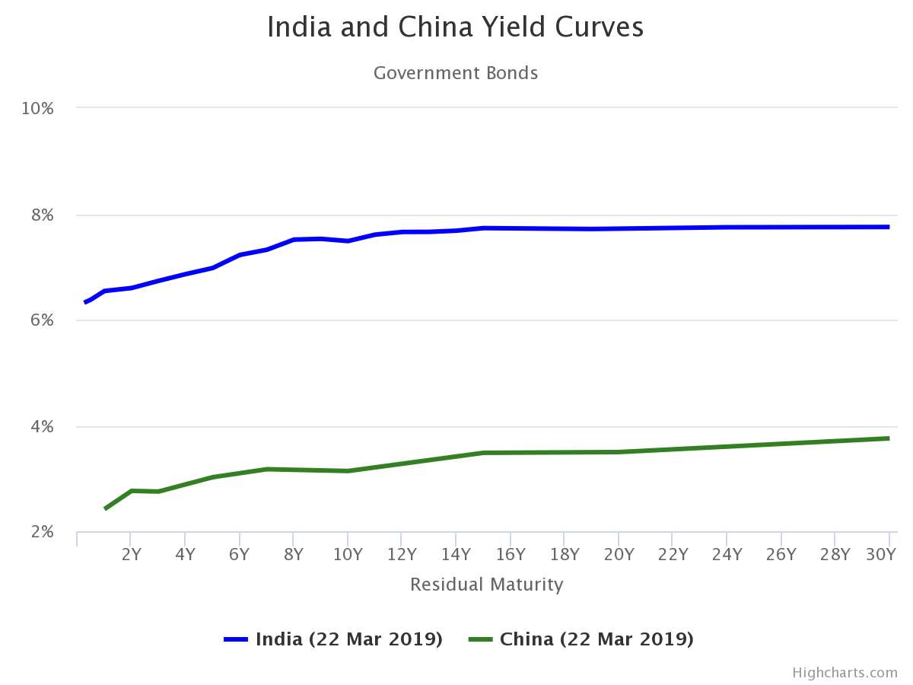
INDIA VS. CHINA

Slide 32
INDIA VS. CHINA
INDIA
S&P: BBB-
Higher yield: 7.486%
Average Spread: 2.43%
CHINA
S&P: A+
Lower yield: 3.139%
Outstanding bonds as % of GDP: 16%
Bonds Turnover Ratio: 0.7
Average Spread: 1.426%
Outstanding bonds as % of GDP: 19%
Bonds Turnover Ratio: 0.39
Notes:
Itll be ideal if it increases to around 20 p as itll

Slide 33
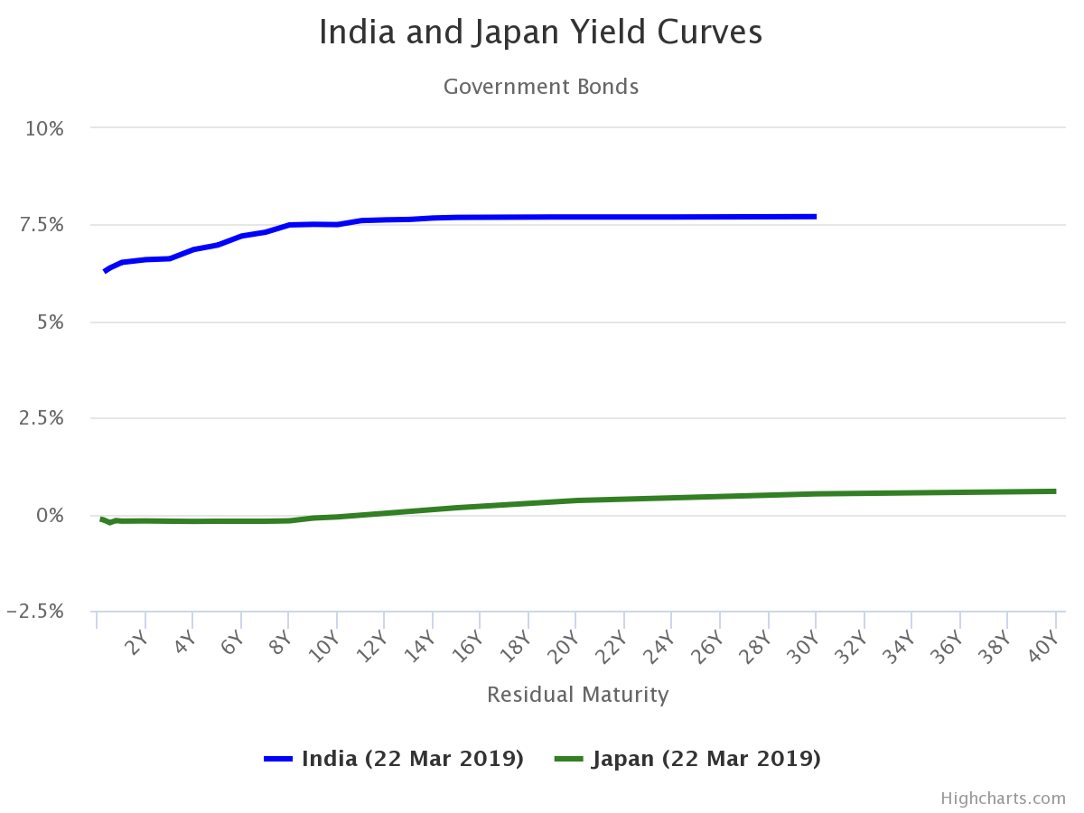
INDIA VS. JAPAN
Notes:
As a thumb rule, when the economy is expected to grow at a brisk pace, equity prices move up and bond yields move up as well since demand for money will be more thereby pushing up interest rates and vice versa. However, the current developments in the US and Indian markets defy this.

Slide 34
INDIA VS. JAPAN
INDIA
S&P: BBB-
Higher yield: 7.486%
Average Spread: 2.43%
JAPAN
S&P: A+
Lower yield: -0.066%
Outstanding bonds as % of GDP: 16%
Bonds Turnover Ratio: 0.7
Average Spread: 0.976%
Outstanding bonds as % of GDP: 14%
Bonds Turnover Ratio: 0.16
Notes:
Japan on the other hand is a developing nation
So the yield is consistent w the credit rating
Additionally japan has a negative yield rate to encourage investment in the economy

Slide 35


CONCLUSIONS
The credit spreads for the companies considered in our study, with a tenure between 3-5 years, is between 0.1% - 4%.
Highly stable companies like LIC Housing Finance with larger market cap have lower spreads as compared to companies like SREI Equipment and Ujjivan Financial Services with smaller market cap.
LIC has the lowest risk-neutral probability of default which is 0.025, followed by SREI(0.32) and then Ujjivan(0.66), which is in agreement with the credit spread values.
The average yield on the LIC bond is 7.17%, followed by SREI(10.08%) and Ujjivan(11.36%).
Notes:
In commodity space, buoyant market is generally coined with a market where prices rise with ease when there are sufficient signals of strength
In other words, a market that experiences plenty of trading activity and on which prices is increasing, rather than falling is referred as buoyant market. It does not mean that the prices will always rise in this market. Sharp fluctuations make buoyant market distinct from common market scenarios. Volatility is the biggest concern in these markets as the prices are rapid to increase and fall with investor sentiment.

Slide 36
CONCLUSIONS (Country-wise)
Comparison | India | China | Japan
Yield | 7.49% | 3.14% | -0.07%
Average Spread | 2.43% | 1.43% | 0.98%
Bond Turnover Ratio | 0.7 | 0.39 | 0.16
Market Depth | 16% | 19% | 14%
India has a fairly developed corporate bond market when compared with some of its Asian peers.
Notes:
Lower P/B ratio – undervalued
Higher P/B ratio – High share price relative to its asset value

Slide 37


LIMITATIONS
Tenure is taken as a weighted average of the company’s bonds.
Structural models cannot be used to realistically determine credit risk.
Due to lack of data, the Multiple Linear Regression Model could not be built for predicting Credit Spreads using the factors.
Credit spreads are influenced by a large number of factors which have not been considered in this analysis.
The companies that are considered in this analysis are very few to draw suitable conclusions about the entire NBFC sector.

Slide 38

FUTURE SCOPE
Study the credit spread puzzle and examine why the Merton model underperforms and generates credit spreads that are different from the observed credit spreads.
Perform factor analysis to identify which factors are the most significant in determining credit spreads.
Analyse the significance of systematic and idiosyncratic variables in predicting credit spreads.
Calculate credit spreads for companies across various sectors and compare the risks.
Notes:
http://www.diva-portal.org/smash/get/diva2:1104766/FULLTEXT01.pdf

Slide 39
ACKNOWLEDGEMENT
We express our sincere respect and gratitude to our mentors Dr. Raghunath M. and Ms. Ashita Dara for their invaluable help, guidance and constant support which have helped us in successfully completing this project.
A special thanks to Mr. Jagabandhu Padhy who provided us with bounteous help.

Slide 40
Thank you

